Slide 1
Status Review
29.01.2018

Slide 2
Last week:
Finished most of the work on the EES modell
Water measuring
Testing with dry air

Slide 3
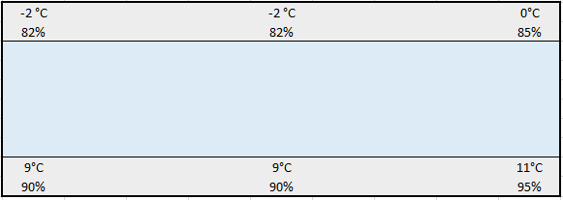
Condensing water
Starttime | Stoptime | Mass water [kg] | Mass water [kg/day] | Cycle
13:00 | 16:00 | 8.888 | 71.10 | 03:00

Slide 4
Evaporator change
Same dimensions but better heat transmission
8K Superheat not possible
E-Valve fully open with 12K SH
Higher mass flow rate
Higher evaporating temperature
Lower condensing temperature
Calculated T_{COND} is lower than T_{water,IN} → bubbles in front of a pressure sensor can lead to a great loss in accuracy
Changed Superheat setting to 13K
Similar performance like old evaporator
=> Because of better heat transmission the charge is not enough

Slide 5
Evaporator Design Comparison
Original LIDL design
modified LIDL design
1
2.1 IN
1.1 IN
1
2.1
1.1
2
3.1 IN
2
3.1
3
3
4
3.4
2.4
4
3.4
2.4
5
1.4
5
1.4
6
3.5
6
3.5
7
7
8
2.5
3.8
8
2.5
3.8fIN
9
1.5
9
1.5
10
10
11
1.8
3.9
11
IN 1.8
3.9
12
2.8
1.9
12
IN 2.8
1.9
13
13
14
2.9
14
2.9
15
1.12 OUT
3.12 OUT
15
1.12 OUT
3.12 OUT
16
2.12 OUT
16
2.12 OUT

Slide 6
To-Do:
Change coil connections
Make corrections for condensing temperature (p_{disch})

